Slide 1

30 Million E-commerce Data Analysis Report
JR Academy
Data Analyst - Helena Li

Slide 2
Report Content
Business Purposes
30 Million Sales Data Exploration
Data Clustering
Recommendations

Slide 3
Business Purposes
Explore customers’ behaviour and predict the possibility of behaviour in the next sales period
Discover customers’ preferences in department, aisles, and products.
Discover the peak order time
Explore the regular pattern hidden in the data

Slide 4
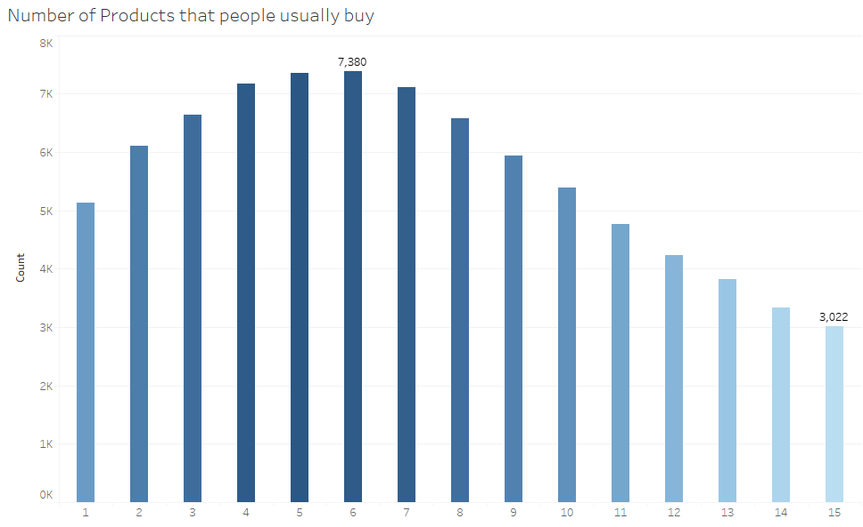
Data Exploration -Number of products that people usually buy

Slide 5
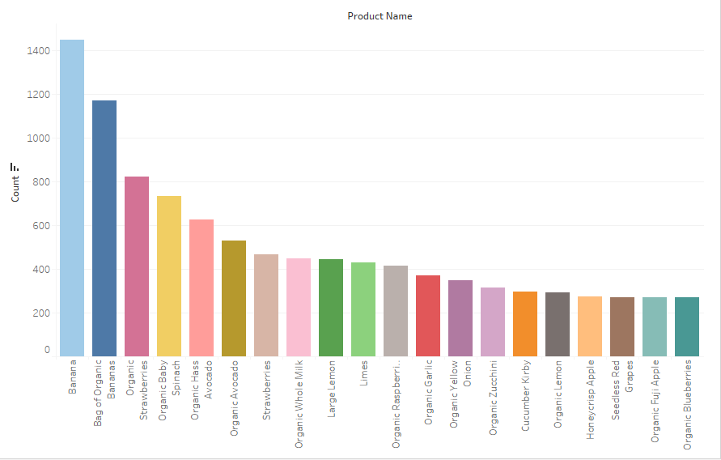
-Popular Products

Slide 6
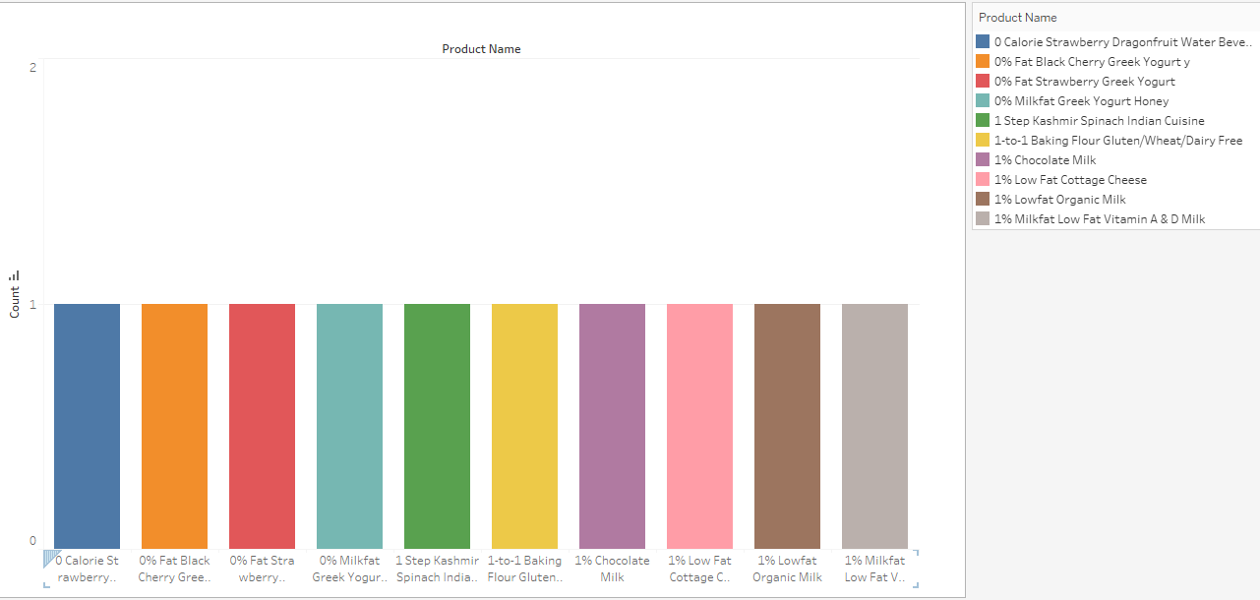
Unpopular products

Slide 7
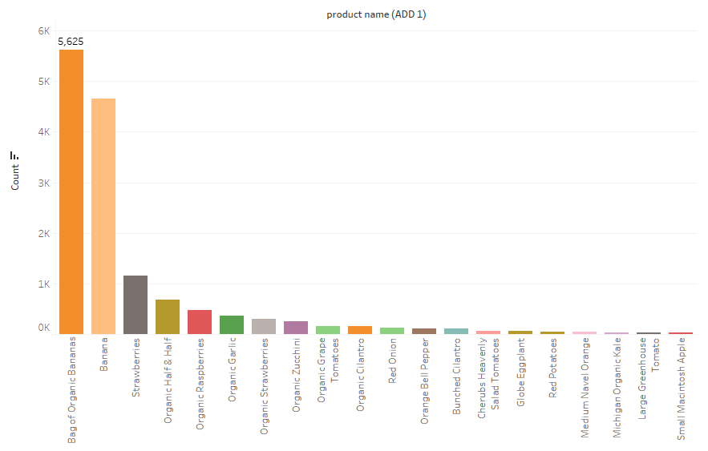
-Popular Product when add to cart is 1

Slide 8
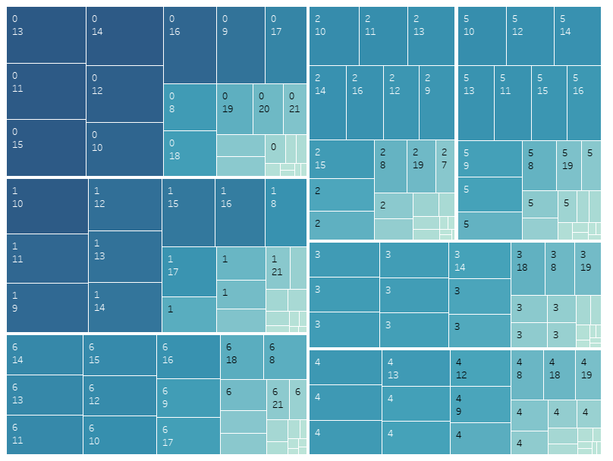
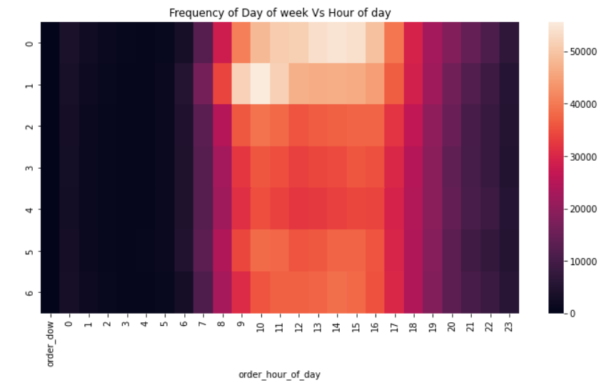
-Heatmap for order dow and hour of time

Slide 9
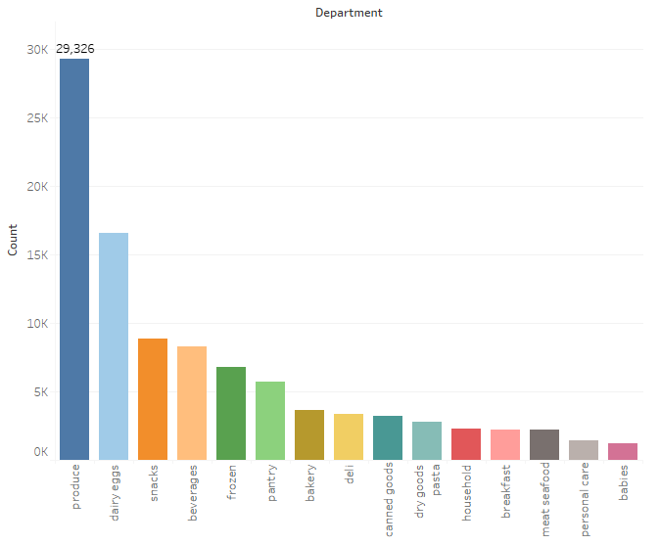
-Popular Departments

Slide 10
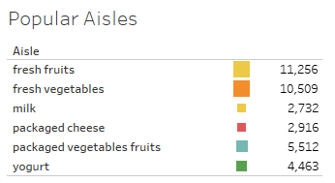
-Popular Aisles

Slide 11
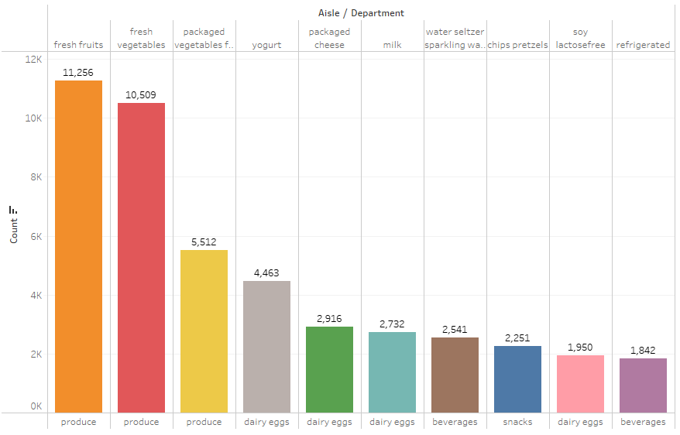
-Best Selling Aisles over All Departments

Slide 12
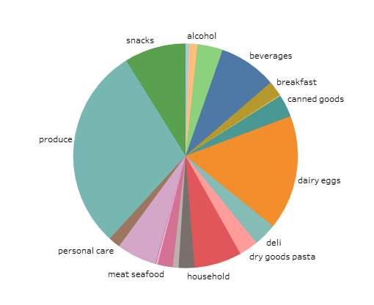
-Department Distribution

Slide 13
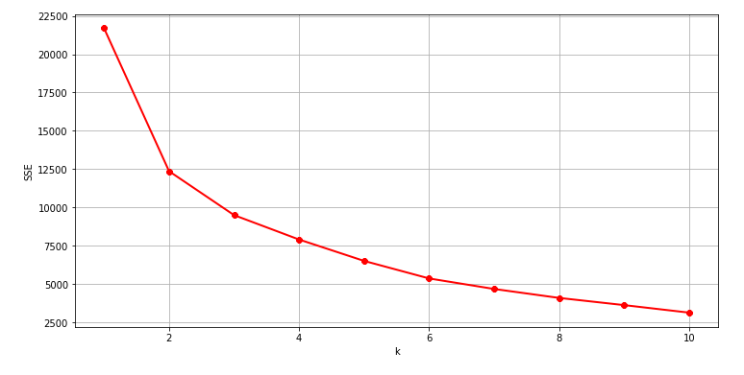
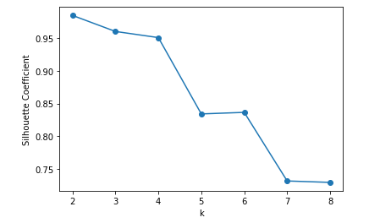
Data Clustering -Elbow Method
-Silhouette_Score Analysis

Slide 14
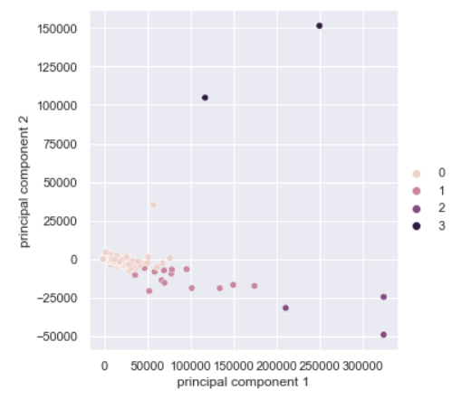
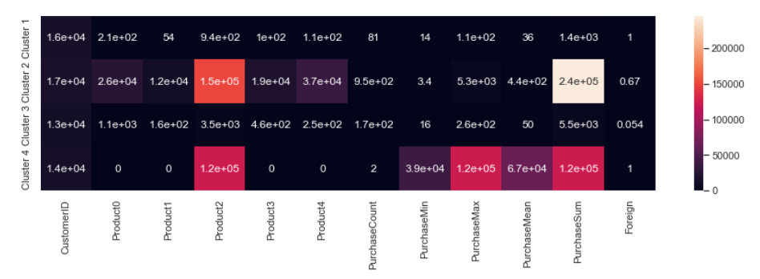
Data Clustering -PCA

Slide 15
Business Recommendations
Increase storage and price of popular products like banana, bag of organic banana
01
Increase product categories in produce department
02
Ensure popular products’ storage in peak order time (increasing company’s order channels)
03
Reduce the price and storage of unpopular products (sales promotion activity) like 0 calories strawberry dragonfruit water beverage
04
Change product manufacturer of unpopular products.
05

Slide 16
Thank You!
For more information:
Company Information: JR Academy https://jracademy.com.au/
Connect information: mingjinhelena@gmail.com

